Slide 1
Wild-life Guard
A Real-time wild-life detection with repelling system
Team - members:
Mohamed Sameer S
Mohamed Rizwan H
Mohammed Aathif M
Mohamed Izzat A
Mohamed Riazdeen M
Mentors:
Libin Anto
Divya K
Divya Konda
Sunil Kumar
Surekha Boha

Slide 2
Introduction
The agriculture sector in India contributes around 18% to the country's GDP. It's also a major source of employment, providing a livelihood for about 42.3% of the population.
However, recent declines are partly attributed to human-animal conflicts, which cause significant resource damage and threaten human lives.
Current Intrusion systems are primarily designed to detect human activity and deter animals, but they often lack efficiency in preventing wildlife intrusions.

Slide 3
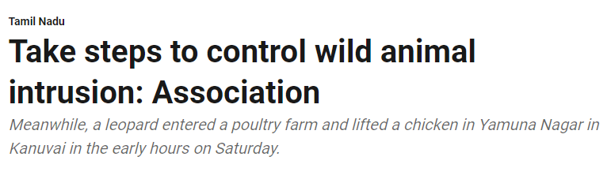
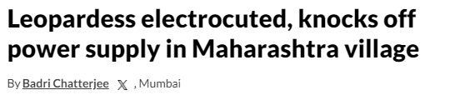
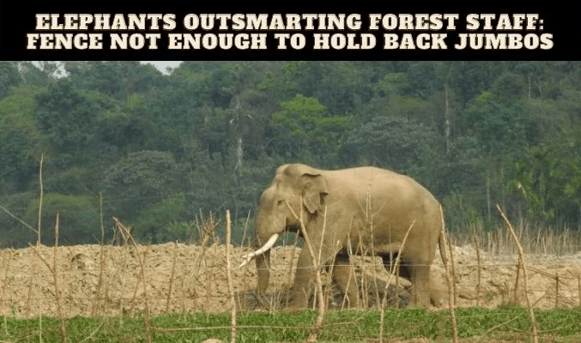
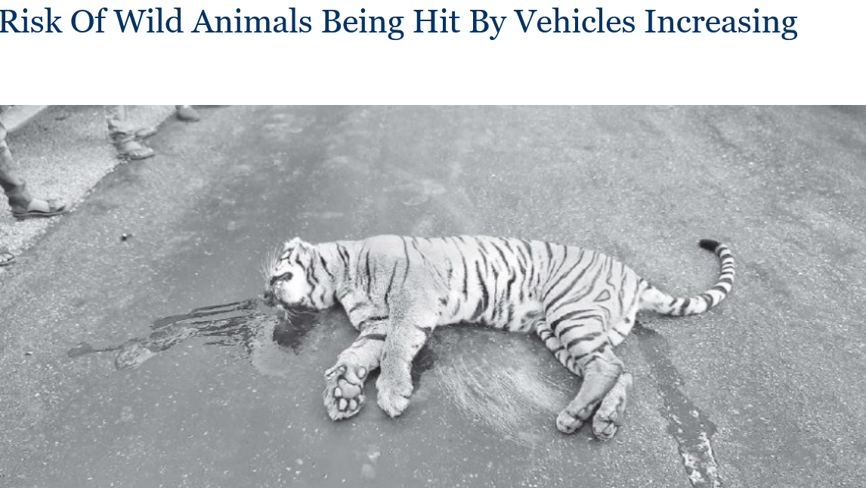
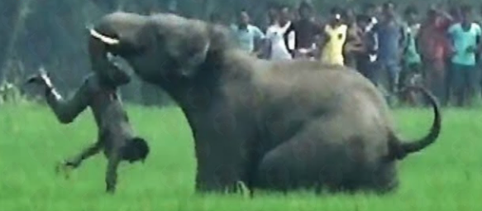
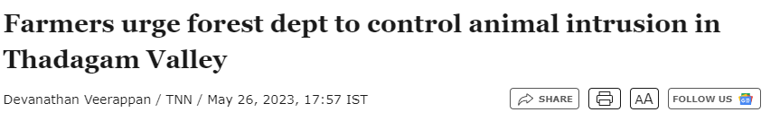
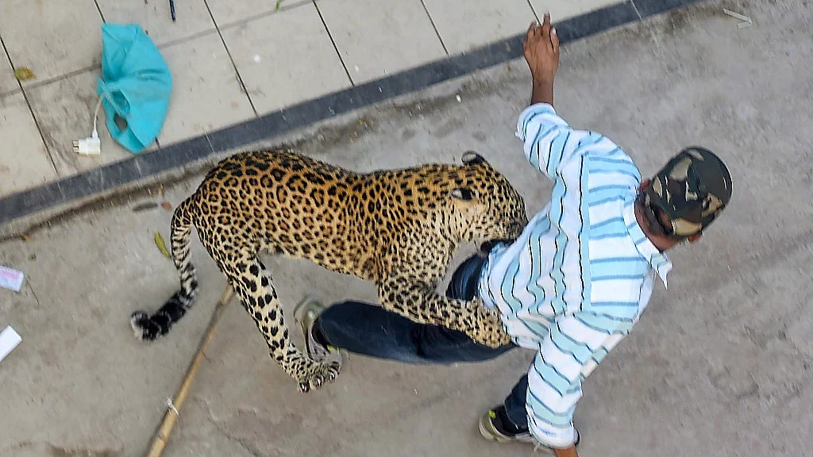
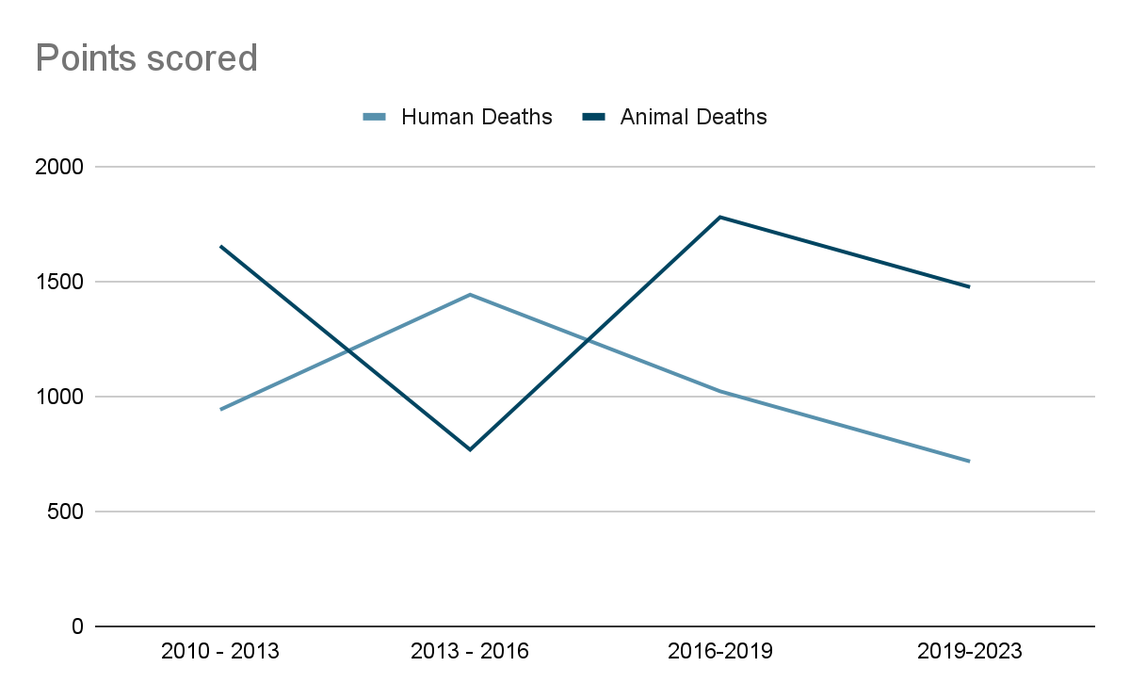
Problem Statement
Wildlife-Related Fatalities: 2010–2023
The graph shows a decline in human deaths from 2010 to 2016, followed by a slight increase up to 2023. Animal deaths peaked in 2016–2019 since the humans deaths decreased.

Slide 4
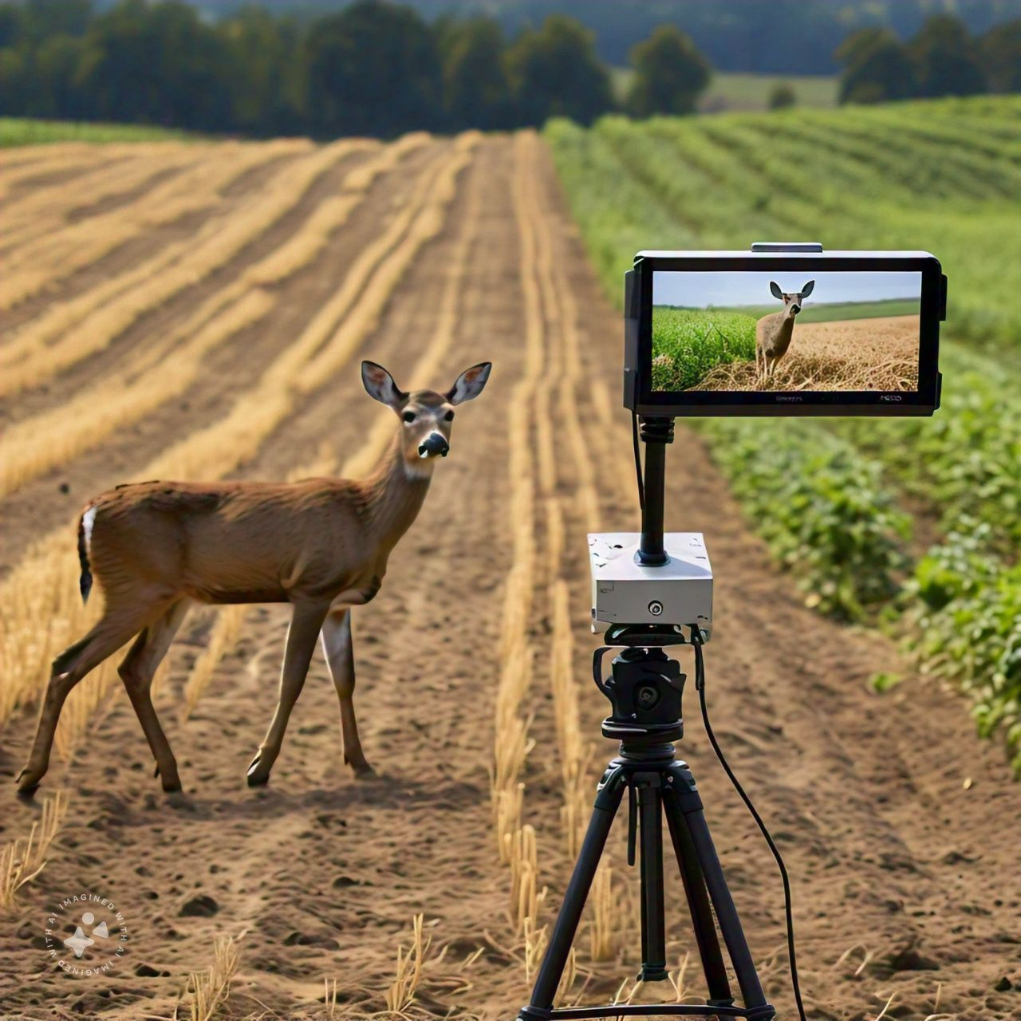
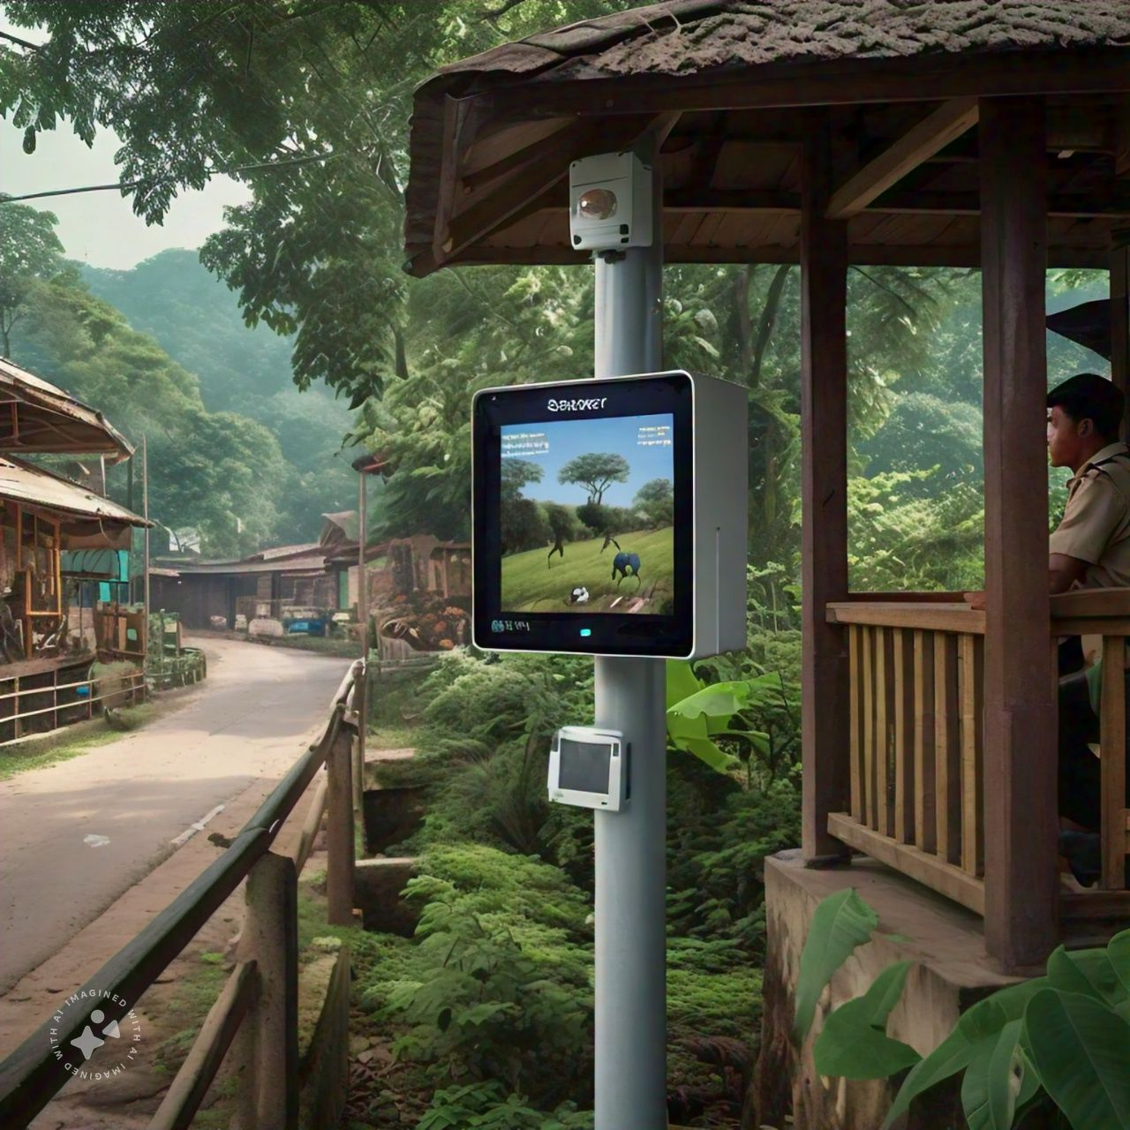

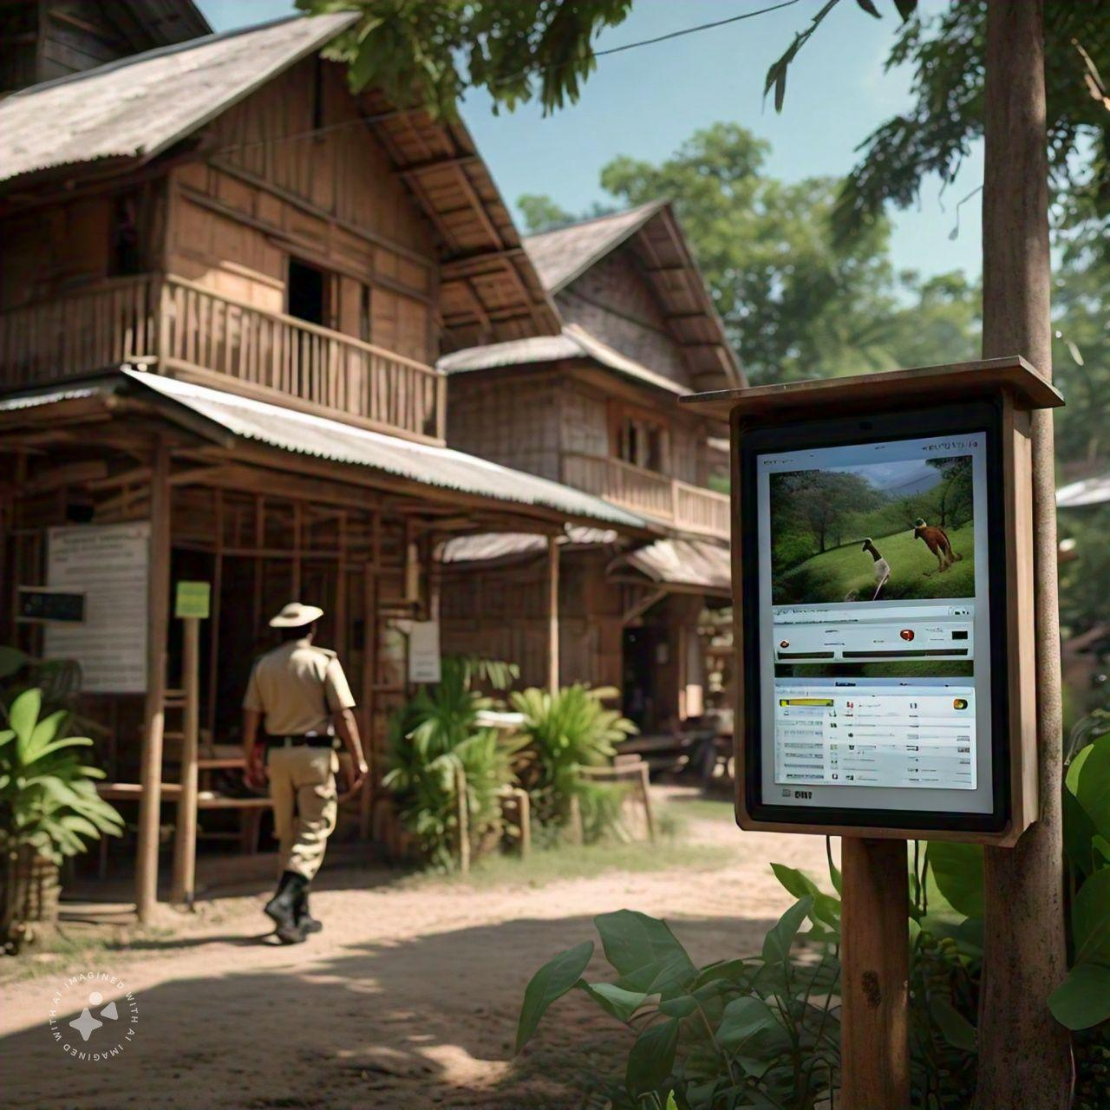
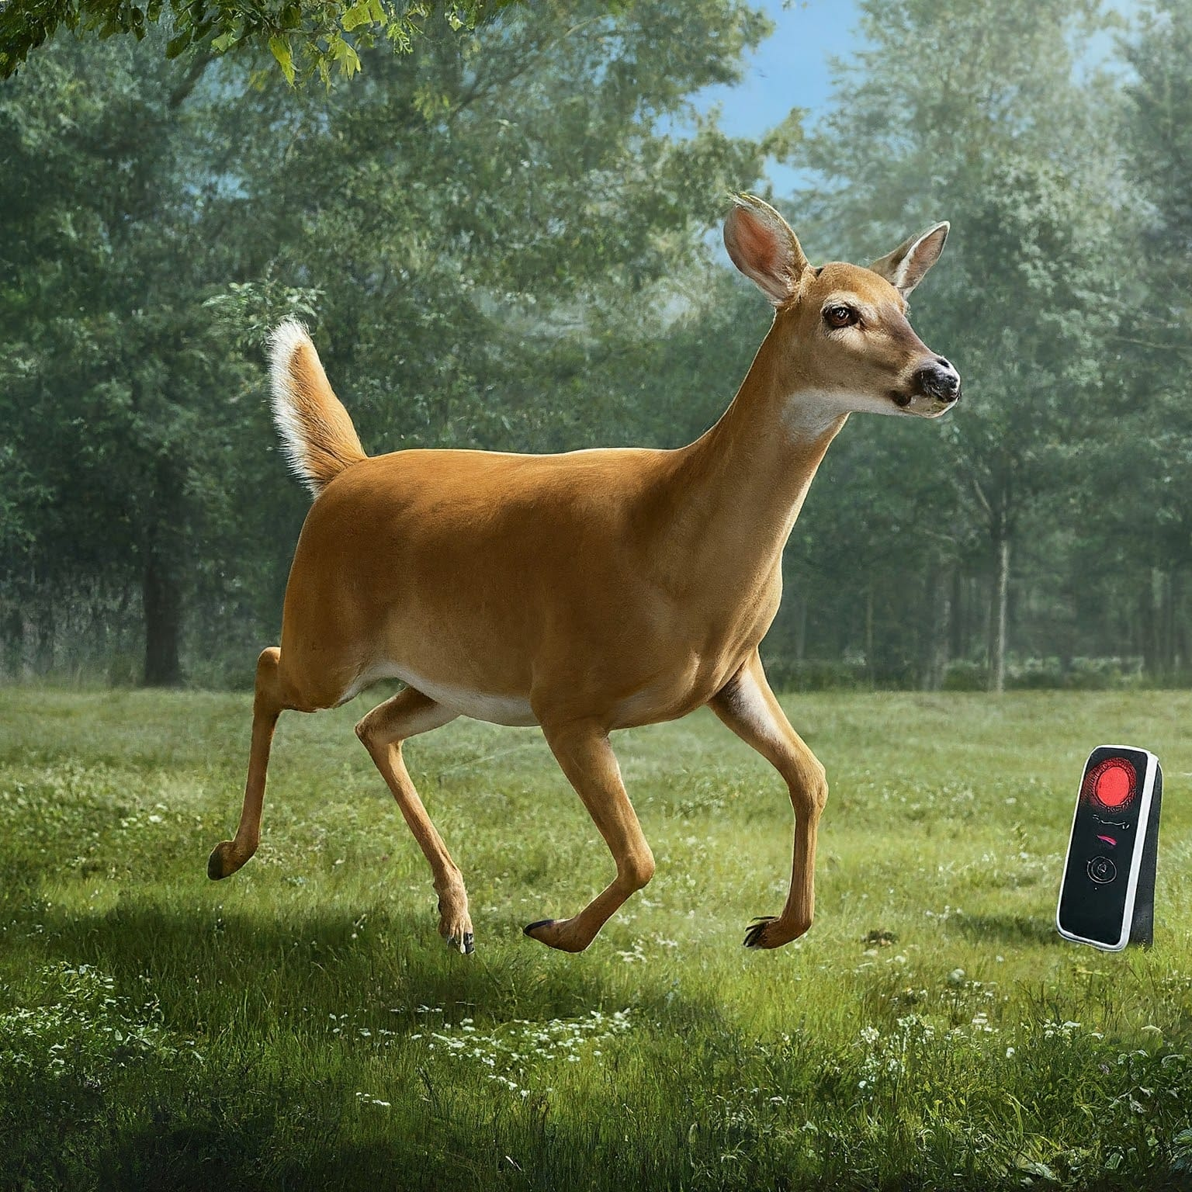
Sensors and cameras cover the entire animal activity area.
Input from sensors and cameras
Creating Safer Environment
The sound is driving animals back.
Examples:
Elephant | 4 kHz - 20 kHz
Tiger | 3 kHz - 5 kHz

Slide 5
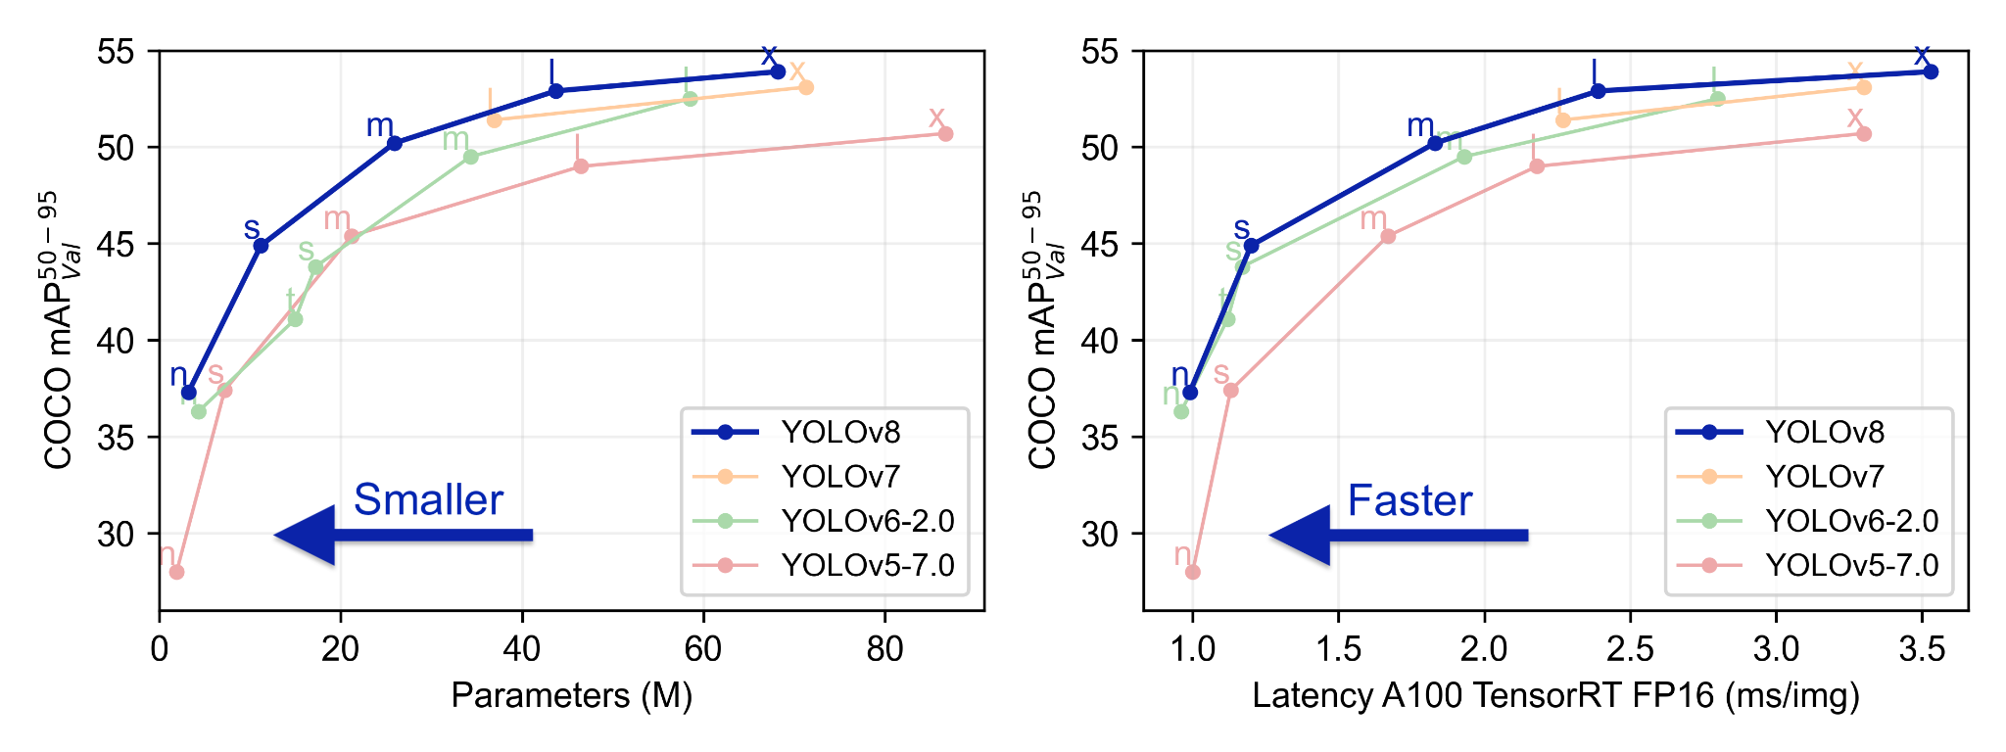
Technical Implementations
Detection Model : YOLOv8
YOLOv8 is a real-time object detection model designed for high accuracy and speed. It is open-source and upgradeable.
High Accuracy: Delivers improved object detection precision for reliable wildlife monitoring.
Real-Time Processing : Enables immediate responses to wildlife detections with fast image and video analysis.
Versatile Deployment : Easily integrates into various platforms, from edge devices to cloud systems.
Robust Performance : Functions effectively in diverse environmental conditions, ensuring reliable detection at all times.

Slide 6
References and other resources
References
Xie, Z., A. Singh, J. Uang, K.S. Narayan and P.Abbeel. Multimodal blending for high-accuracy Instance cognition. In: 2013 IEEE/RSJ International Conference on Intelligent Robots and Systems. Tokyo: IEEE 2013, pp. 2214-2221. ISBN 978-1-4673-6356-3. DOI: 10.1109/IROS.2013.
Tiber Trnovszky, Patrik Kamencay, Richard Orjesek, Miroslav Benco, Peter Sykora. Animal recognition system based on convolutional neural network.
Ahonen, T., Hadid, A., Pietikainen, and M.: Face description with local binary patterns: Application to face recognition. IEEE ΤΡΑΜΙ 28(12), 2037-2041 (2006).
Burghardt, T., Calic, J.: Real-time face detection and tracking of animals. In: Neural Network Applications in Electrical Engineering. pp. 27{32. IEEE (2006).
Felzenszwalb, P.F., Girshick, R.B., McAllester, D., Ramanan, D.: Object detection with discriminatively trained part based models. IEEE ΤΡΑΜΙ 32(9), 1627-1645(2010).
He, K., Zhang, X., Ren, S., Sun, J.: Deep residual learning for image recognition. In: CVPR. pp. 770-778 (2016).
Other Resources
Links for articles regarding the animal intrusions : click here
Links for other research papers : click here
Links for Frequencies affecting animals research papers links : click here

Slide 7
DEMO

Slide 8
Conclusion
Our Wildlife Guard provides real-time protection against wildlife intrusions, ensuring safer villages and fostering harmony between humans and wildlife.
By protecting wildlife and ensuring community safety, we aim to promote a harmonious balance.let’s safeguard our communities and wildlife with innovative technology and proactive solutions for a safer and more sustainable future.
Thank you for your time and attention.

